Slide 1
Orientation session for Workshop Laboratory
Lab In-charge:
Karthick Kumar, Lab engineer, SOE
Menahallah, Lab Internee, SOE
Karim, Lab Internee, SOE

Slide 2
Table of contents
To understand how workshop lab function & approach for appointment.
Understanding laboratory guidelines and safety rules.
3D Printing – Practical
Laser cutting- Practical
List of Other Machines and Tools- Hand Drill Practical
List of Workshop machining Process
Q & A

Slide 3
Workshop Laboratory Function
Understanding and analyzing the lab user requirements.
Knowledge in workshop lab, work process, and health & safety.
Understanding health & safety in your work process.
Fill and submit the workshop permit form.(work permit form)
5. Train the user for particular process and provide safety gear (PPE).
6. Book the lab for activity – max 4 group and max 3 hours.
7. Approval from the Lab In-charge is mandatory.

Slide 4
Lab Guidelines
Follow general, train the equipment, safety, housekeeping.
Aware of safety signage in the workshop lab.
Lab guidelines form:
3D Printing form:
Request lab in-charge for additional requirements, process, and any support.

Slide 5
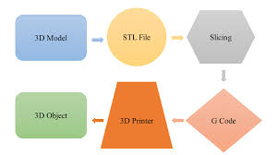
3D printing or additive manufacturing
Construction of a three-dimensional object from a CAD model. It can be done in a variety of processes in which material is deposited, joined or solidified under computer control, with the material being added together, typically layer by layer.
Coordinates in 3D Printing.
3D printing techniques:
Filament Printing -FDM
Resin Printing -DLP, SLA, LCD & MSLA SLS
Injection Printing - Bio Prints.
3D Print Format - .obj, .stl from 3D raw format to .obj, .stl
Printer acceptable format: G & M Codes
Types of material: PLA, TPU, Nylon-CF, ABS etc

Slide 6
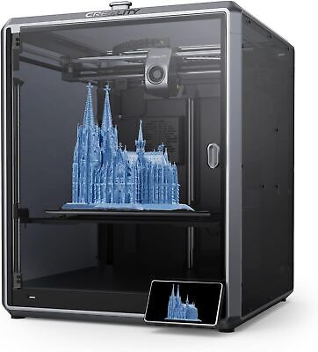
FDM Print Settings:
Material Selection & Settings – Temp, selection, bed heating,
Orientation , Scaling or edit the model
Layer height ( recommended 0.1 – 0.2mm)
Infill settings
Shell – minimum 2 shell
Supports – for bridging model
Print Speed- 200 to 300mm/s
Base support – raft, brim etc

Slide 7
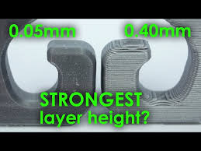
Layer height
Layer height refers to the height of each layer in the 3D printing model.

Slide 8
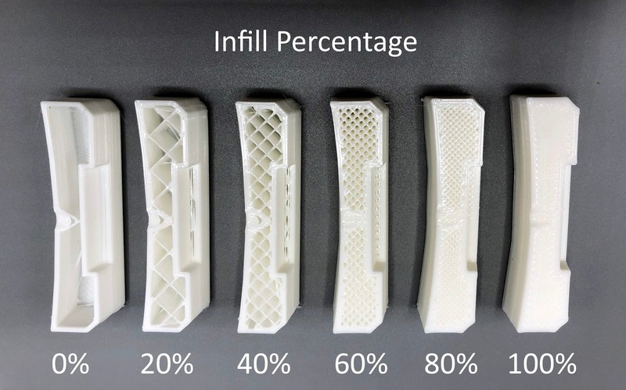
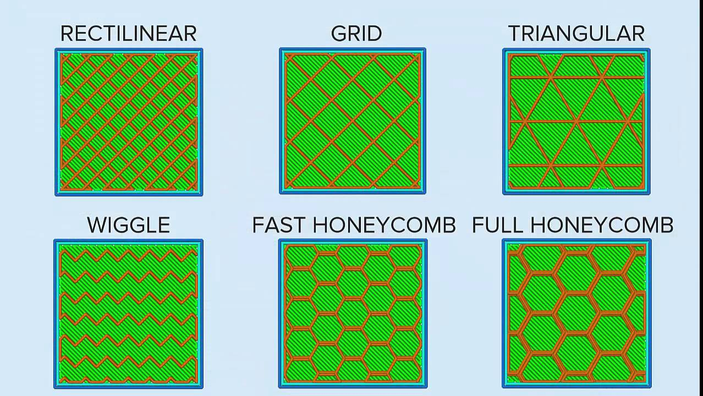
Infill Settings
The infill is the material between the walls of the geometry. Filling the volume.
Infill density: 15 -100%
Infill types:
High Strength for dynamic movement, low strength for prototypes

Slide 9
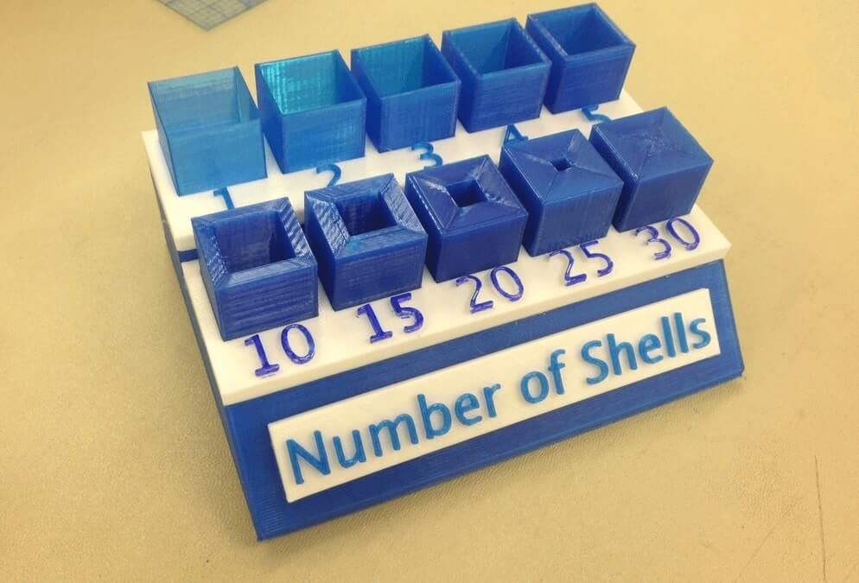
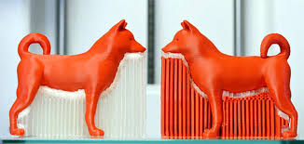
Shell & Supports:
Shells are the number of layers on the outside of a print.
The support structure is the added part that supports the overhanging structure or bridge structure when slicing the model, which needs to be removed after printing.

Slide 10
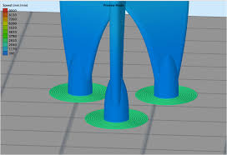
Base Layer
Sacrificial initial layers used to stabilize the part on the build tray to create a strong foundation and ensure a level build plane.
Types of base layer: No base layer, Brim, Raft. Skirt etc…

Slide 11
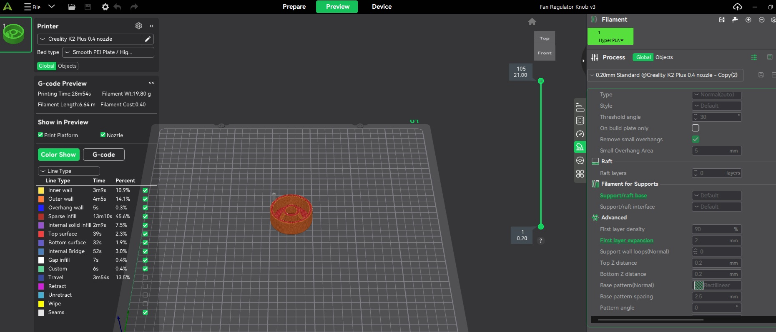
Creality Print Slicing software

Slide 12
Laser Cutting
What it is
How it works
A laser cutting machine employs a high-focused, high-powered laser beam to cut or engrave materials such as wood, acrylic, metal, paper, leather, etc. The laser beam melts, burns, or vaporizes the material, resulting in precise cutting or engraving.
A laser beam is generated and directed through mirrors and lenses. It is focuses on a small spot for high energy density. A CNC system uses vector paths from selected design files to guide the beam over the material. Depending on the settings, it cuts through or engraves the material surface.

Slide 13
Laser Machine Specs, Processes, & Application
Specs:
Working Area: 1300 x 900 mm
Laser Power Options: 60 (RF Laser) – 120 W (CO₂ laser)
Laser Type: Sealed-off CO₂ laser, water-cooled
Max Workpiece Height: 125 mm
Precision: 0.05 mm or above
Speed: Up to 2 m/s (depending on material & power)
Process:
A laser is focused using a lens for cutting/engraving.
Design is transferred from software (like CorelDRAW) to the laser machine through the Trotec JobControl software.
Material is placed on the cutting bed, usually with an air assist or vacuum bed.
The extruder should be moved to the desired location on above the material and then focused using the focusing key.
The laser follows the vector paths and executes the operation based on settings.

Slide 14
Laser Machine Specs, Processes, & Application
Applications :
Cutting: Acrylic, wood, leather, paper, fabrics.
Engraving: Plastics, glass, rubber, anodized aluminum.
Used in: signage, product prototyping, model-making, custom crafts, packaging, etc.

Slide 15
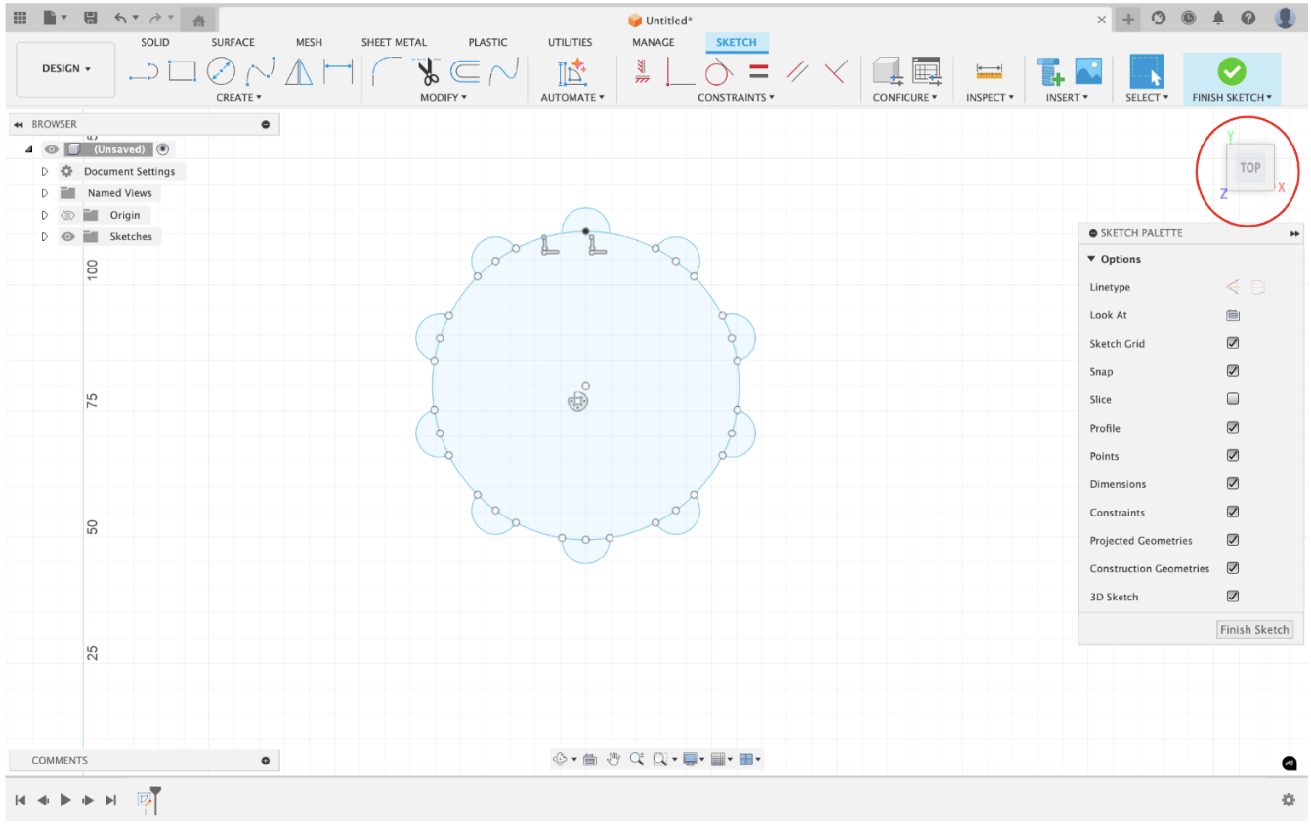
Example
The design can be done using Fusion360 or AutoCAD and must be 2D and created in the top view only:

Slide 16
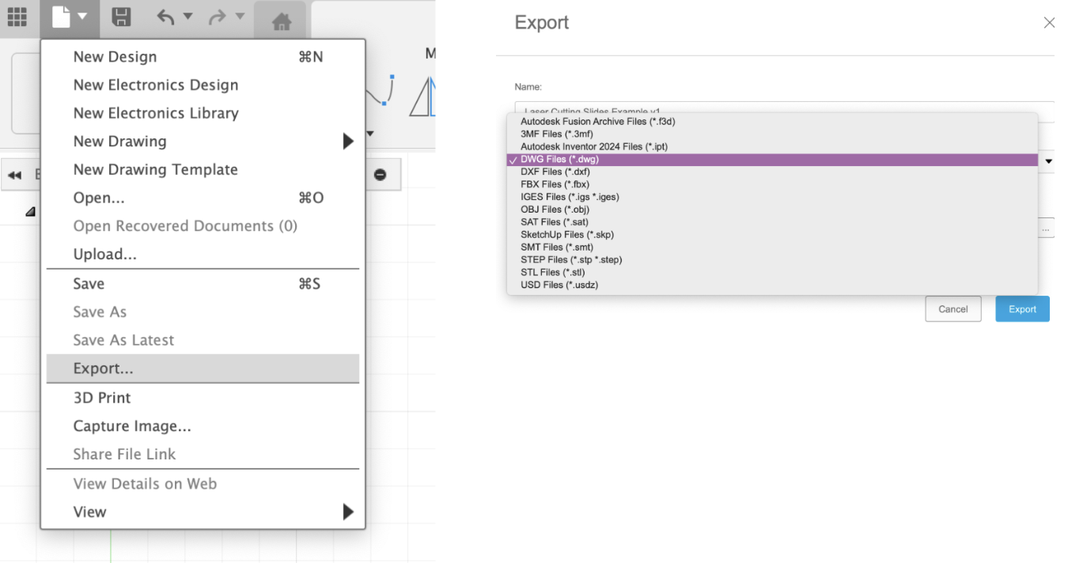
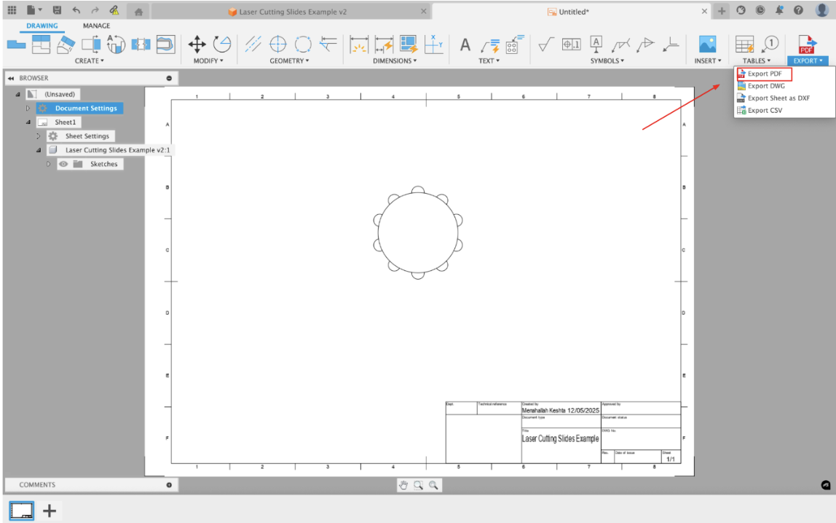
Example
The file must then be exported as a .dwg file Or the drawing may be saved as a pdf and utilised as well (make sure the orientation is set at the top view)

Slide 17
Trotec Print Settings
After importing the CAD file into the CorelDRAW software, select which line to cut or engrave by right-clicking the black or red color box, respectively. Also, make sure the lining of the design is set to hairline at the top of the toolbar.
Next, select the entire design and make sure to group the design before clicking on the print icon on the top left of the software.
Follow it by clicking on the selection icon, and then go to the layout tab to select the fit-to-page option. Afterwards, go back to the general tab to click on the gear icon, which will open a new settings tab that connects the design to JobControl. Then copy down the dimensions of the design in the settings pop-up.
Next, save the settings and click on the JC icon, then the apply and print buttons on the print pop-up to begin transferring the CorelDraw Document to the laser cutter.
When the Job Control software opens, draw the file that appears in the top right drop-down menu to where you would like to begin laser cutting relative to the extruder head.
Finally, click on the materials icon at the end of the top right menu to choose the material selection based on thickness, and make sure to save the desired material settings before starting the laser cutting procedure by clicking the bottom right start button.

Slide 18
List of Other Machines & Tools
Conventional Lathe
Conventional Mill
Drill Press – Drilling & Tapping process
Portable Drills
Impact Driver
Jig Saw
Hot Gun
Dremel Crafting tool – Metal & Plastics
Band Saw – wood works
Metal Cutting - MetalsGrinding machine
CNC Lathe
Electric screw drivers + Sockets/bits
Hand Saw, Hammers, Pliers, cutters, scribers, marking tools, etc
Measurement Devices: Ruler, measuring tape, vernier caliper, thread gauge, Right angle, level gauge, micrometer etc..

Slide 19
List of Machining Process
Drilling
Boring
Tapping- Internal & External Threads
Turning
Milling
Slotting
Profile cutting – Non-metal and metal
Shaping
Crafting
Grinding
Polishing
Rolling
Sheet metal cutting
Surface finishing
Cutting- metal & non-metal

Slide 20
Thanks!
Any Questions?

